Slide 1

Software Engineering – MsCV : 3D Scanner
By Romain CORSIN and Kevin DESCHARRIERES
Supervise by Jiang Cansen and Strubel David

Slide 2
Contents
Introduction
Debugging
Interface GUI
Class diagram
Comments
Conclusion

Slide 3
Introduction
Last year projects
Goal
The way to follow
Debugging
Interface
Comments

Slide 4
Debugging
Study of the last year programs and reports
Group 1: https://github.com/umaatgithub/3D-KORN
Group2 : https://github.com/WajahatAkhtar/Project-S.E
Group 3 : https://github.com/AnirudhPuligandla/3D_scanner
Group 4 : https://github.com/tazleef/Software-Engineering-Project

Slide 5






Debugging
Necessary elements

Slide 6
Debugging
Necessary paths
C:\Qt\Qt(version)\(version)\msvc2015 64\bin
QT_QPA_PLATFORM_PLUGIN_PATH
C:\Qt\Qt(version)\(version)\msvc2015 64\plugins\platforms
PCL_ROOT as C:\Program Files\PCL 1.8.0
%PCL_ROOT%\bin
…
.pro paths
INCLUDEPATH += ”C:\...”
LIBS += ”-LC:Files1.8.0”

Slide 7
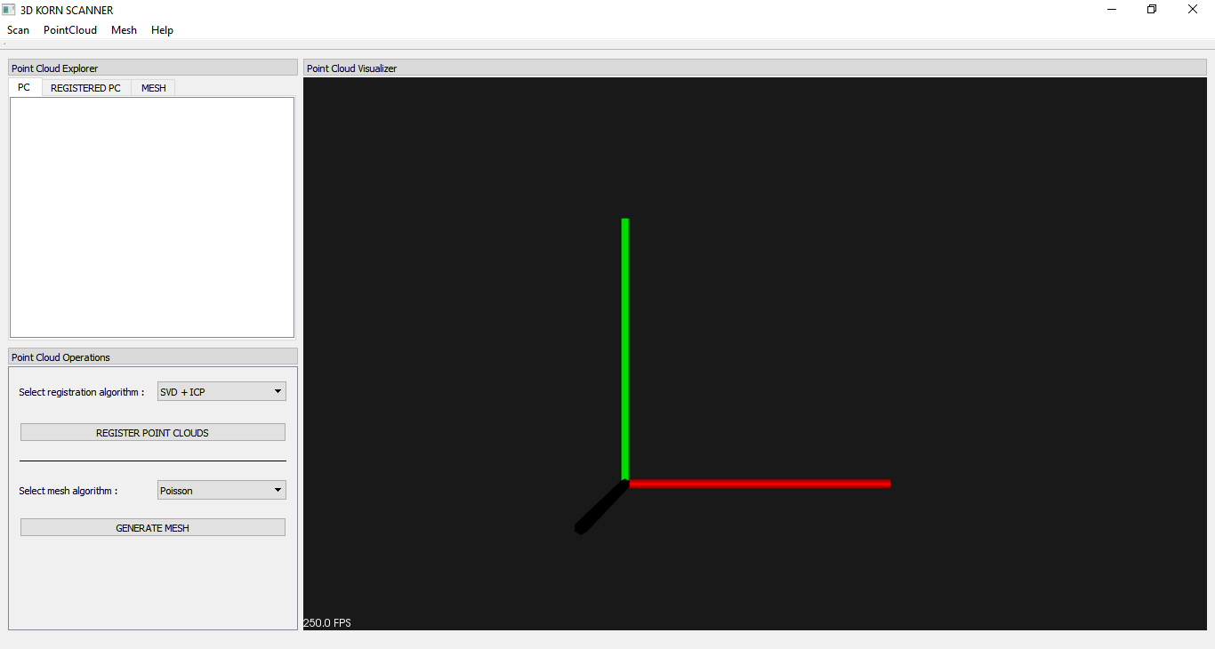
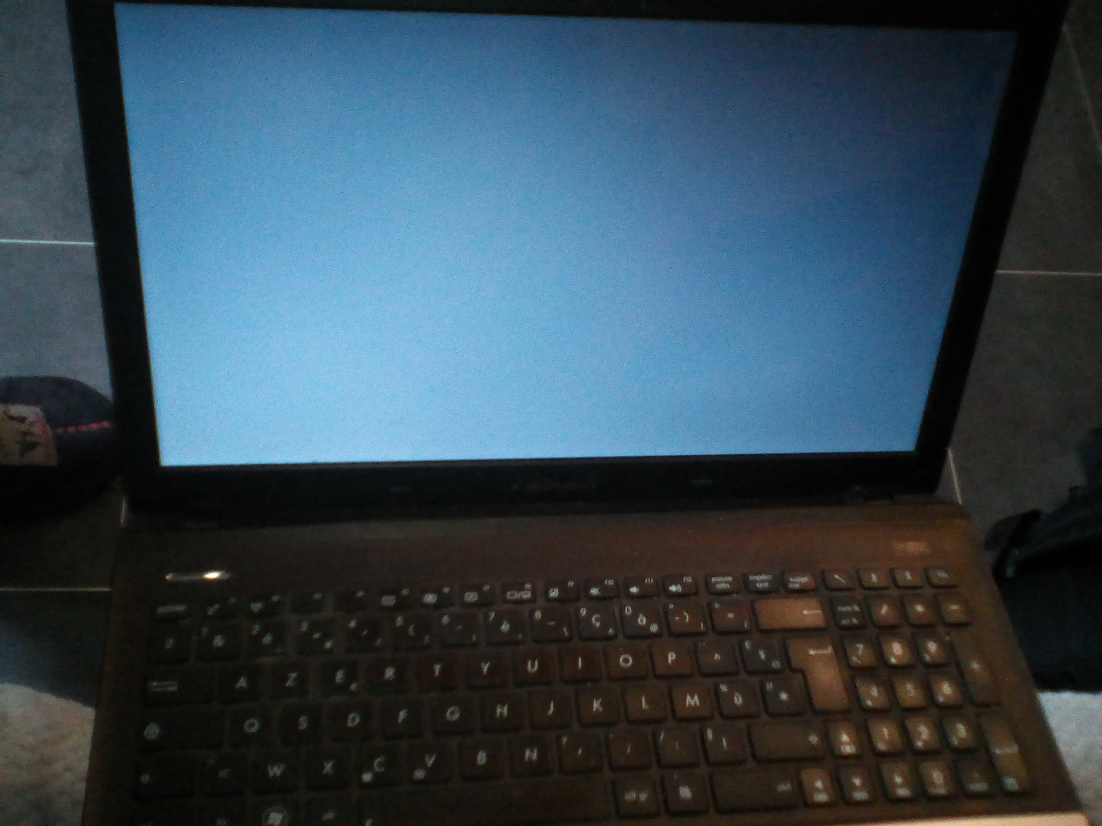
Debugging
Success
Dead laptop
Interface of the 3D KORN SCANNER

Slide 8
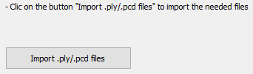
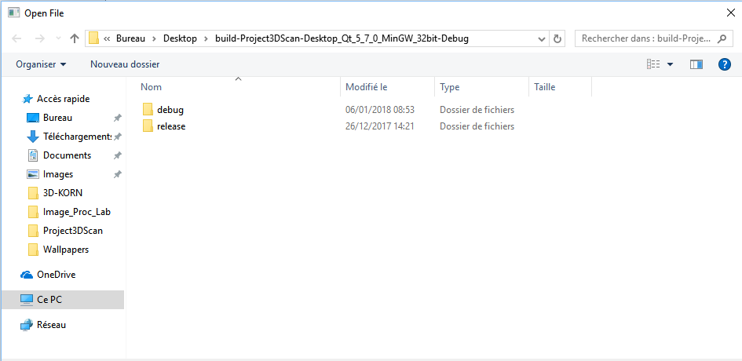
Interface
Button and DialogBox
Button to open the dialogBox

Slide 9

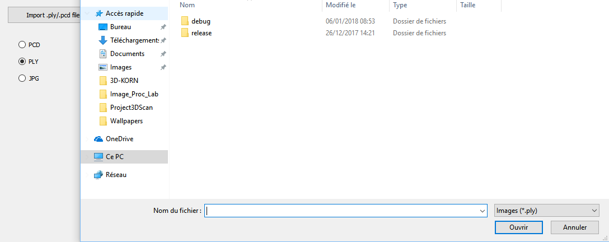
Interface
Radio buttons
Different radio buttons to choose the good format of files. (Here jpg is for the examples)

Slide 10
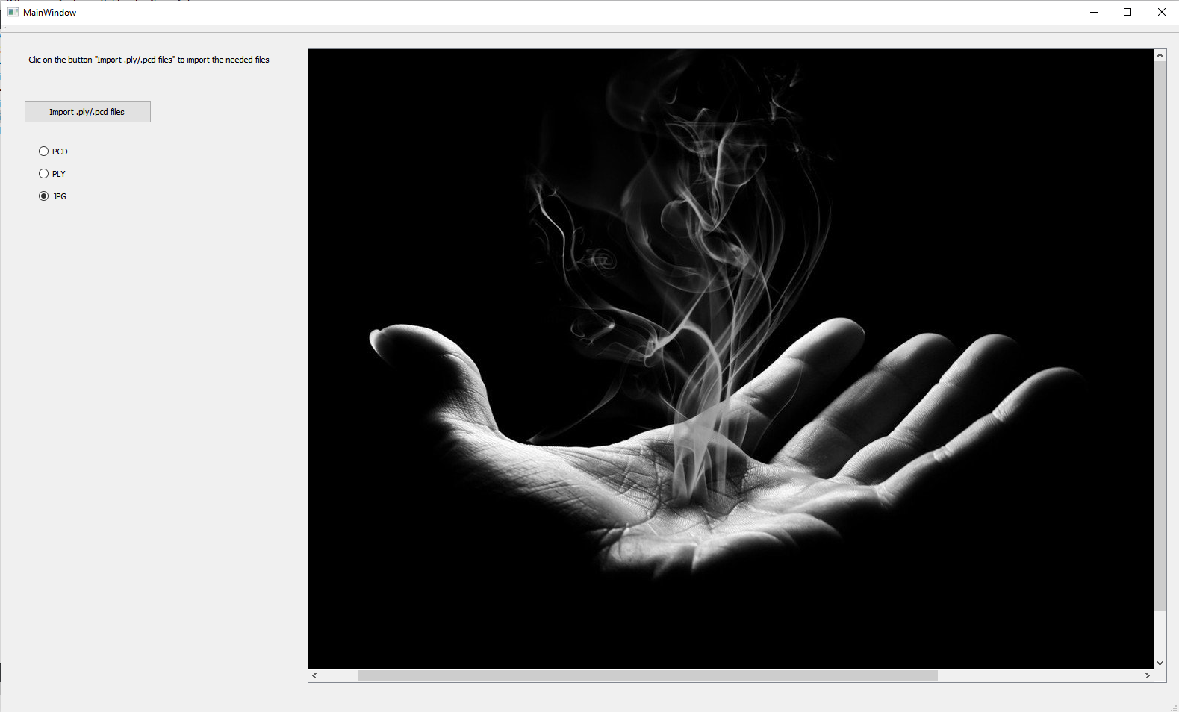
Interface
Displaying

Slide 11
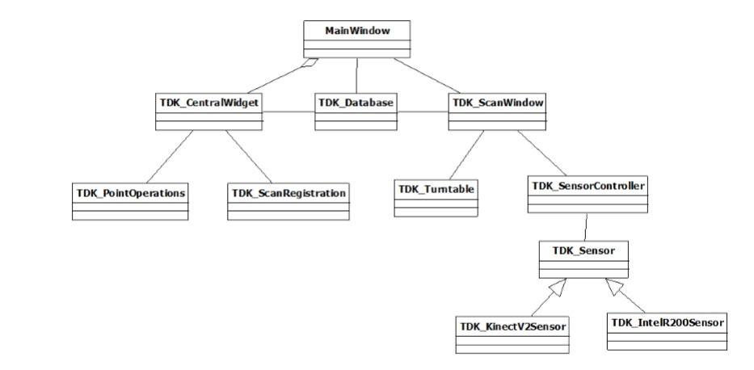
Class diagram

Slide 12
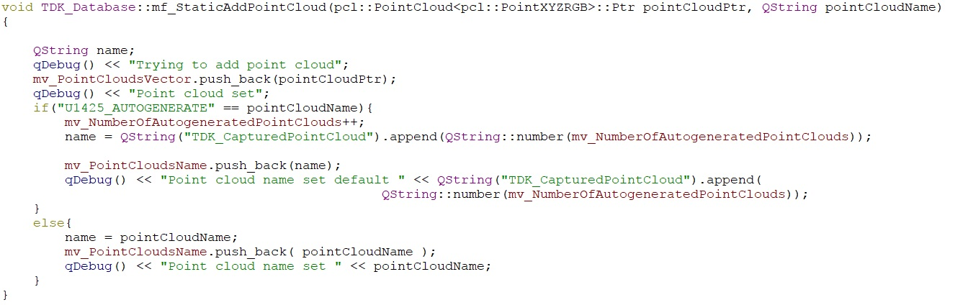
Comments
Uncommented code

Slide 13
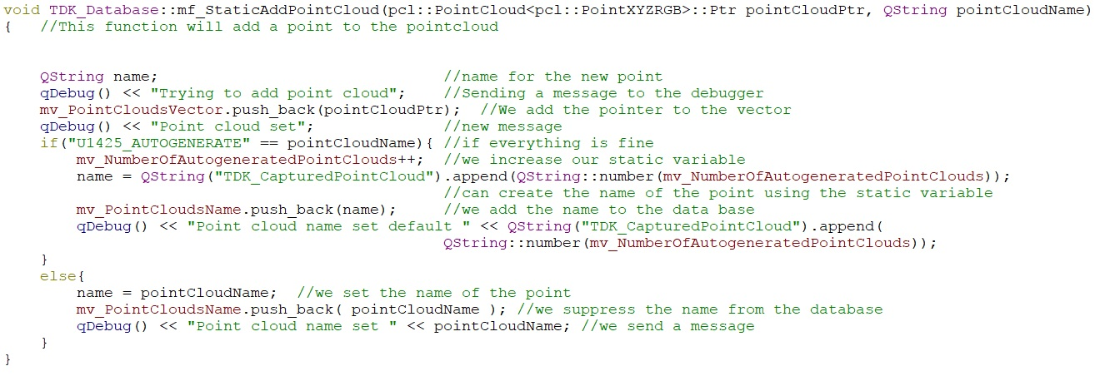
Comments
Same code but commented

Slide 14
Conclusion
Issues
What we have learned?
To go further

Slide 15

Any questions?

